Slide 1
AI

Slide 2
Artificial Intelligence
8.2.4.
Adversarial Search (Ch 6)

Slide 3
Outline
Games
Optimal decisions
Alpha-beta pruning

Slide 4
Outline
Imperfect decisions
Stochastic games
Partially observable games
State-of-the art game programs

Slide 5
Example Game
Three bins
You choose a bin. I choose a number from that bin
You want to maximize your score
Contents of the bins
A = -50 50
B = 1 3
C = -5 15
Strategies
Cooperative: pick A
Competitive: pick B
Uniform Random: pick C
Example from Percy Liang

Slide 6
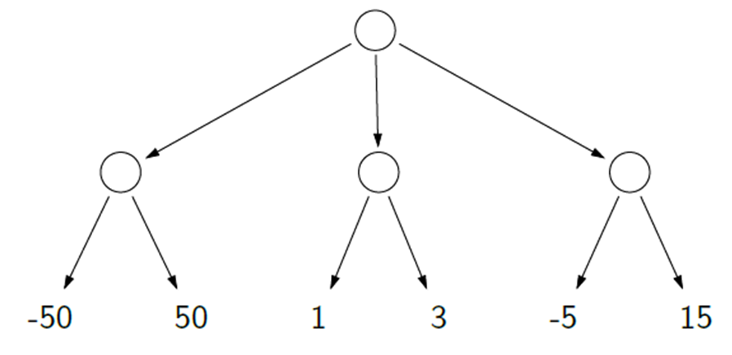
Game Tree

Slide 7
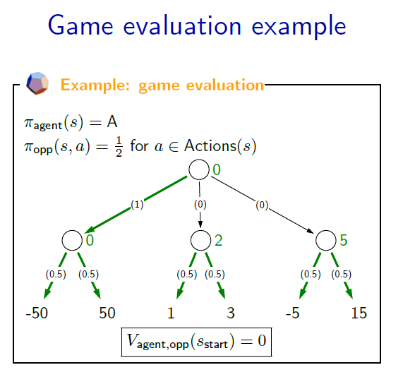
Example from Percy Liang

Slide 8
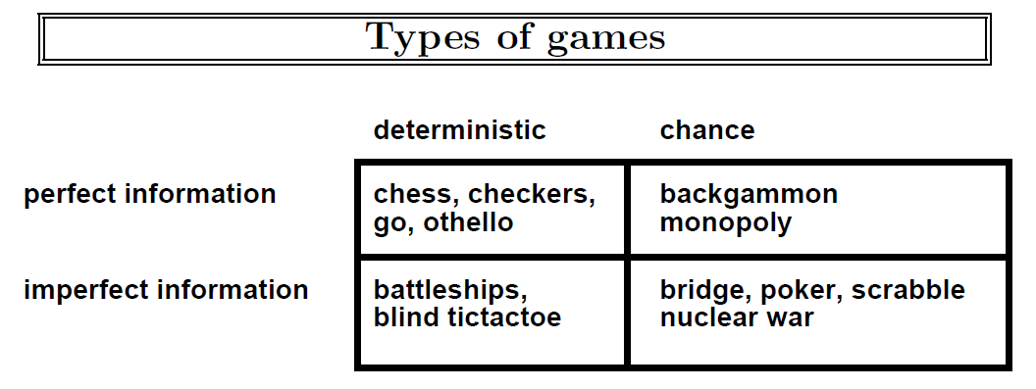

Slide 9
Games vs. search problems
"Unpredictable" opponent → specifying a move for every possible opponent reply
Time limits → unlikely to find goal, must approximate

Slide 10
Minimax Search
Core of many computer games
Pertains primarily to:
Turn based games
Two players
Players with “perfect knowledge”

Slide 11
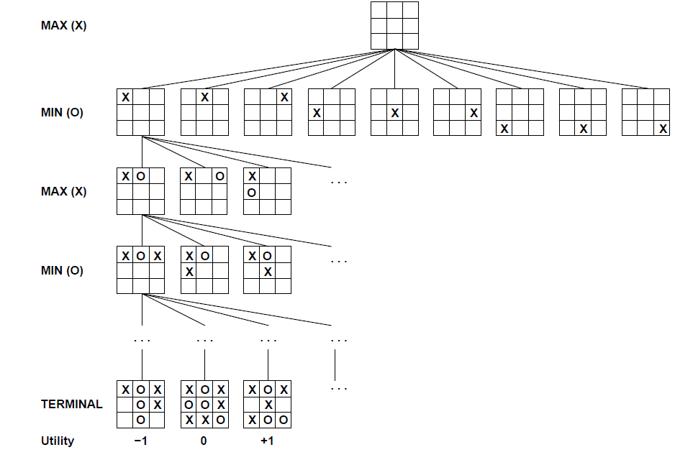
Game tree (2-player, deterministic, turns)

Slide 12
Game Tree
Nodes are states
Edges are decisions
Levels are called “plys”

Slide 13
Naïve Approach
Given a game tree, what would be the most straightforward playing approach?
Any potential problems?

Slide 14
Minimax
Minimizing the maximum possible loss
Choose move which results in best state
Select highest expected score for you
Assume opponent is playing optimally too
Will choose lowest expected score for you

Slide 15
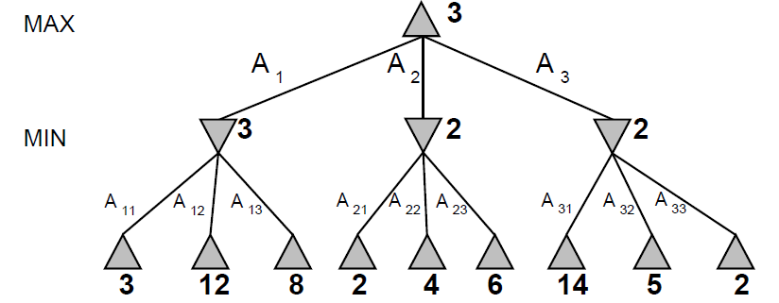
Minimax
Perfect play for deterministic games
Idea: choose move to position with highest minimax value = best achievable payoff against best play
E.g., 2-ply game:

Slide 16
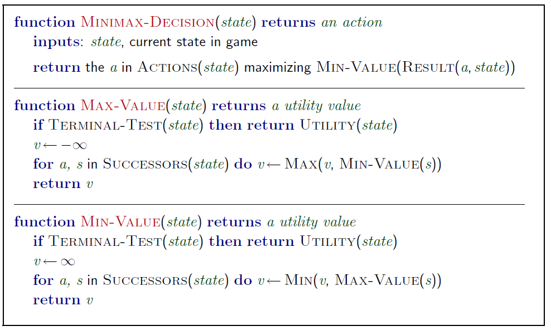
Minimax algorithm

Slide 17
Properties of minimax
Complete? Yes (if tree is finite)
Optimal? Yes (against an optimal opponent)
Time complexity? O(b^{m})
Space complexity? O(bm) (depth-first exploration)
For chess, b ≈ 35, m ≈100 for "reasonable" games → exact solution completely infeasible

Slide 18
Resource limits
Suppose we have 100 secs, explore 10⁴ nodes/sec → 10⁶ nodes per move
Standard approach:
cutoff test:
e.g., depth limit (perhaps add quiescence search)
evaluation function
= estimated desirability of position

Slide 19
Demo
http://homepage.ufp.pt/jtorres/ensino/ia/alfabeta.html

Slide 20
Evaluation Functions
Assign a utility score to a state
Different for players?
Usually a range of integers
[-1000,+1000]
+infinity for win
-infinity for loss

Slide 21
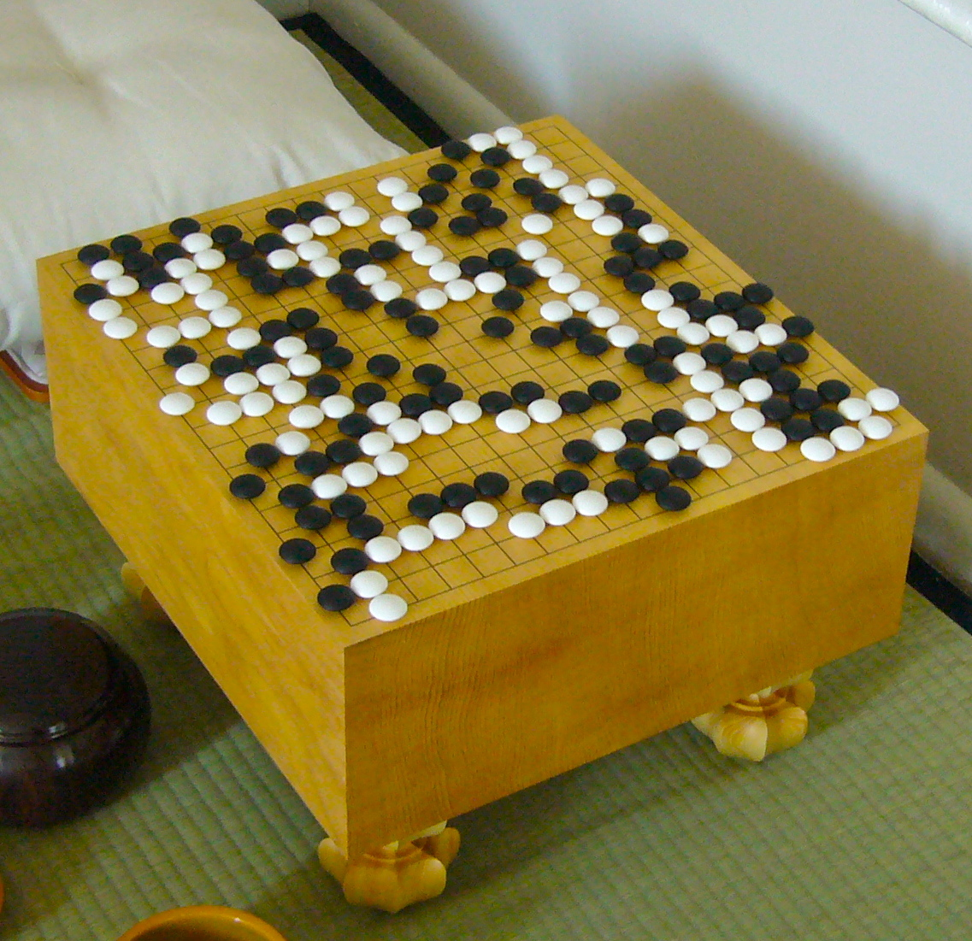
Approximating the Evaluation Function
Use machine learning to learn the weights of the features
This is still intractable in the space of all policies
Monte Carlo simulation
Go – 361 possible moves, depth also 361
By Goban1 - Own work, Public Domain, https://commons.wikimedia.org/w/index.php?curid=15223468

Slide 22
Cutting Off Search
How to score a game before it ends?
You have to fudge it!
Use a heuristic function to approximate state’s utility

Slide 23
Cutting Off Search
MinimaxCutoff is identical to MinimaxValue except
Terminal? is replaced by Cutoff?
Utility is replaced by Eval
Does it work in practice?
b^{m} = 10⁶, b=35 → m=4
4-ply lookahead is a hopeless chess player!
4-ply ≈ human novice
8-ply ≈ typical PC, human master
12-ply ≈ Deep Blue, Kasparov
(A computer program which evaluates no further than its own legal moves plus the legal responses to those moves is searching to a depth of two-ply. )

Slide 24
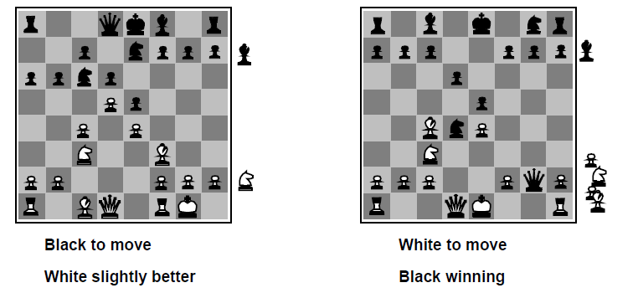
Evaluation Function

Slide 25
Example Evaluation Function
For chess, typically linear weighted sum of features
Eval(s) = w₁ f₁(s) + w₂ f₂(s) + … + w_{n} f_{n}(s)
w₁ = 10¹⁰, f₁(s) = (number of white kings) – (number of black kings), etc.
w₂ = 9, f₂(s) = (number of white queens) – (number of black queens), etc.
5 for rooks, 3 for knights, 2 for bishops, 1 for pawns

Slide 26
Evaluating States
Assuming an ideal evaluation function, how would you make a move?
Is this a good strategy with a bad function?

Slide 27
Look Ahead
Instead of only evaluating immediate future, look as far ahead as possible

Slide 28
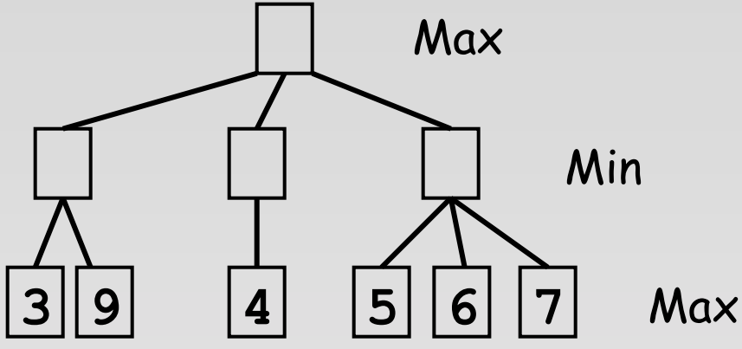
Look Ahead

Slide 29
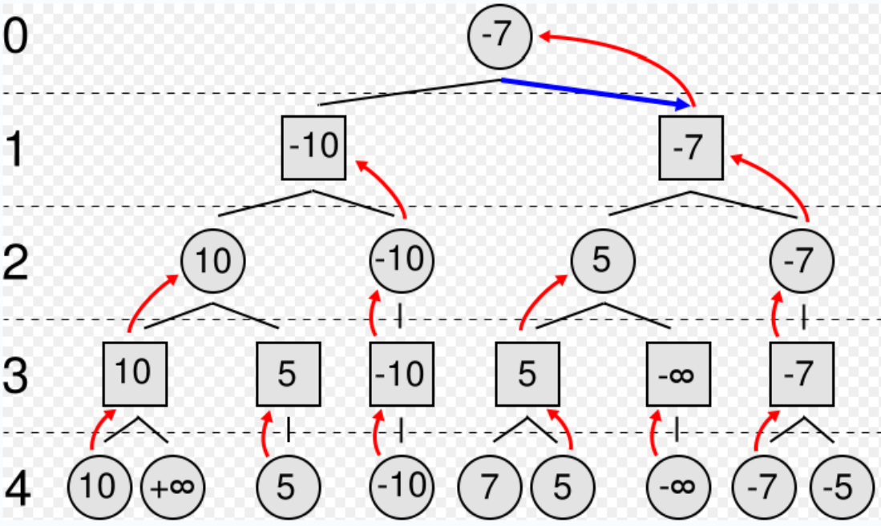
Bubbling Up
Looking ahead allows utility values to “bubble up” to the root of the search tree

Slide 30
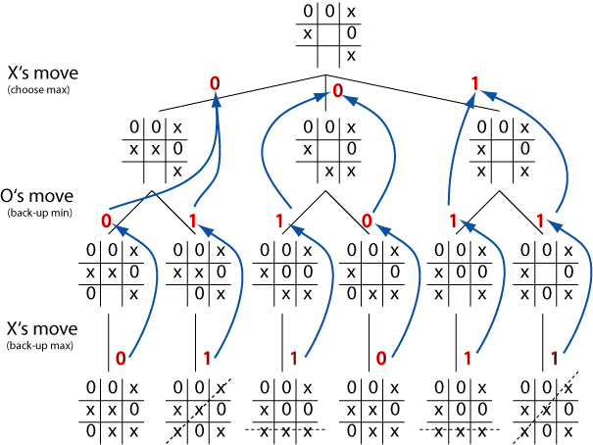
Tic-tac-toe Example

Slide 31
Recap
What is a zero sum game?
What is a game tree?
What is Minimax?
Why is it called that?
What is its space complexity?
How can the Minimax algorithm be simplified?
Will this work for all games?

Slide 32
Next Up
Recall that minimax will produce optimal play against an optimal opponent if entire tree is searched
Is the same true if a cutoff is used?

Slide 33
Horizon Effect
Your algorithm searches to depth n
What happens if:
Evaluation(s) at depth n is very positive
Evaluation(s) at depth n+1 is very negative
Or:
Evaluation(s) at depth n is very negative
Evaluation(s) at depth n+1 is very positive
Will this ever happen in practice?

Slide 34
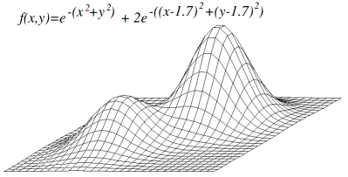
Local Maxima Problem

Slide 35
Search Limitation Mitigation
Sometimes it is useful to look deeper into game tree
We could peak past the horizon…
But how can you decide what nodes to explore?
Quiescence search

Slide 36
Quiescence Search
Human players have some intuition about move quality
“Interesting vs “boring”
“Promising” vs “dead end”
“Noisy” vs “quiet”
Expand horizon for potential high impact moves
Quiescence search adds this to Minimax

Slide 37
Quiescence Search
Additional search performed on leaf nodes
if looks_interesting(leaf_node):
extend_search_depth(leaf_node)
else:
normal_evaluation(leaf_node)

Slide 38
Quiescence Search
What constitutes an “interesting” state?
Moves that substantially alter game state
Moves that cause large fluctuations in evaluation function output
Chess example: capture moves
Must be careful to prevent indefinite extension of search depth
Chess: checks vs captures

Slide 39
Search Limitation Mitigation
Do you always need to search the entire tree?
No!
Sometimes it is useful to look less deeply into tree
But how can you decide what branches to ignore?
Tree pruning

Slide 40
Tree Pruning
Moves chosen under assumption of optimal adversary
You know the best move so far
If you find a branch with a worse move, is there any point in looking further?
Thought experiment: bag game

Slide 41
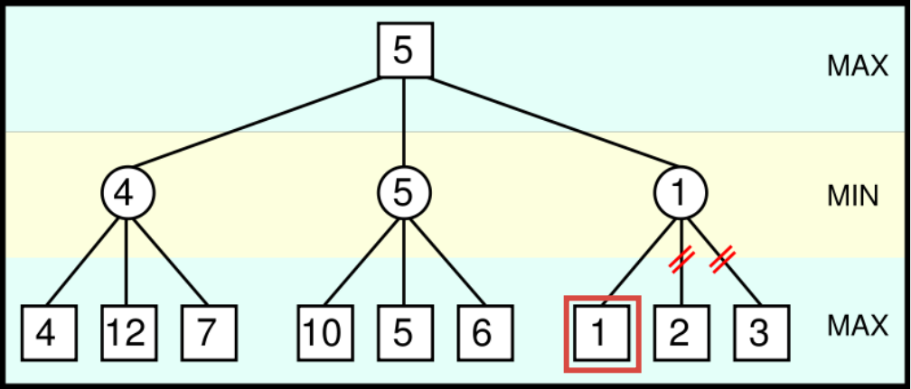
Pruning Example

Slide 42
Alpha-Beta Pruning
During Minimax, keep track of two additional values
Alpha
Your best score via any path
Beta
Opponent’s best score via any path

Slide 43
Alpha-Beta Pruning
Max player (you) will never make a move that could lead to a worse score for you
Min player (opponent) will never make a move that could lead to a better score for you
Stop evaluating a branch whenever:
A value greater than beta is found
A value less than alpha is found

Slide 44
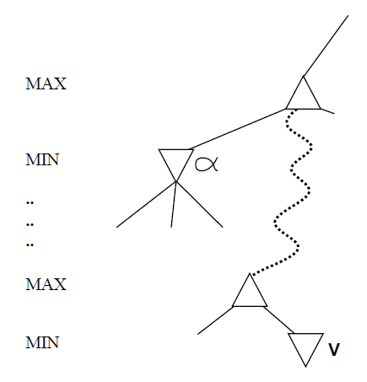
Why is it called α-β?
α is the value of the best (i.e., highest-value) choice found so far at any choice point along the path for max
If v is worse than α, max will avoid it
→ prune that branch
Define β similarly for min

Slide 45
Alpha-Beta Pruning
Based on observation that for all viable paths utility value n will be α <= n <= β

Slide 46

Alpha-Beta Pruning
Initially, α = -infinity, β=infinity

Slide 47

Alpha-Beta Pruning
As the search tree is traversed, the possible utility value window shrinks as
Alpha increases
Beta decreases

Slide 48

Alpha-Beta Pruning
Once there is no longer any overlap in the possible ranges of alpha and beta, it is safe to conclude that the current node is a dead end

Slide 49
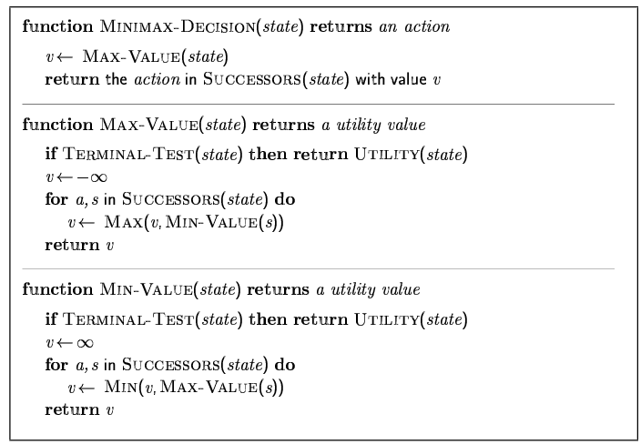
Minimax algorithm

Slide 50
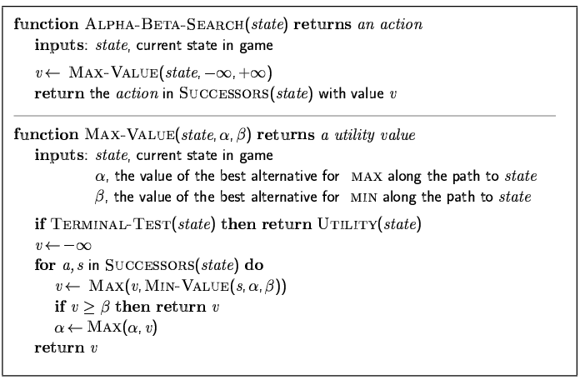
The α-β algorithm

Slide 51
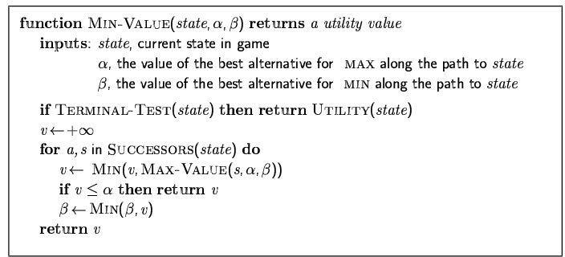
The α-β algorithm

Slide 52
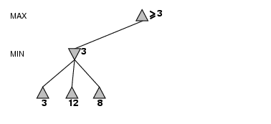
α-β pruning example

Slide 53
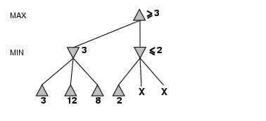
α-β pruning example

Slide 54
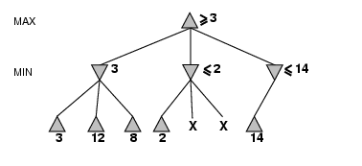
α-β pruning example

Slide 55
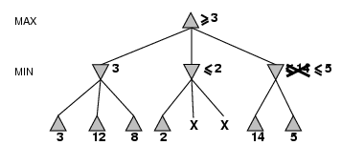
α-β pruning example

Slide 56
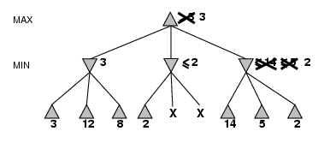
α-β pruning example

Slide 57
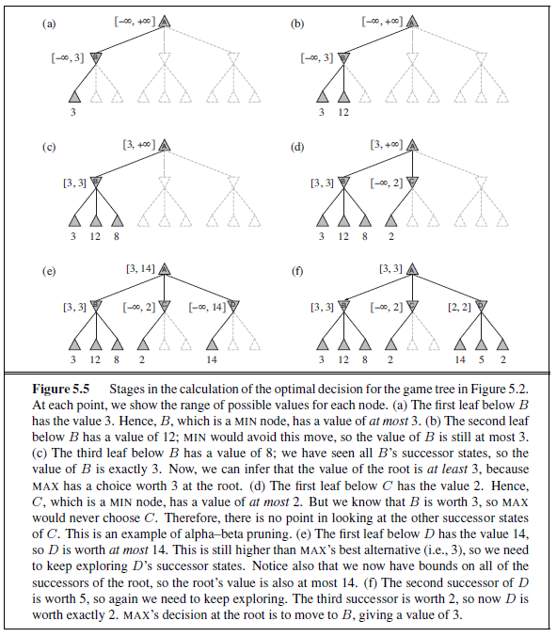

Slide 58
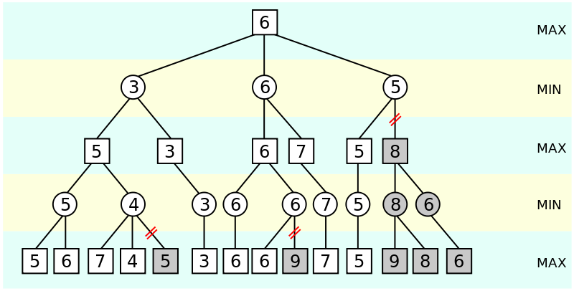
Another α-β Pruning Example

Slide 59
Tree Pruning vs Heuristics
Search depth cut off may affect outcome of algorithm
How about pruning?

Slide 60
Move Ordering
Does the order in which moves are listed have any impact of alpha-beta?

Slide 61
Move Ordering
Techniques for improving move ordering
Apply evaluation function to nodes prior to expanding children
Search in descending order
But sacrifices search depth
Cache results of previous algorithm

Slide 62
Properties of α-β
Pruning does not affect final result
Good move ordering improves effectiveness of pruning
With "perfect ordering," time complexity = O(b^{m/2})
→ doubles depth of search
A simple example of the value of reasoning about which computations are relevant (a form of metareasoning)

Slide 63
Deterministic games in practice
Checkers
Chinook ended 40-year-reign of human world champion Marion Tinsley in 1994. Used a pre-computed endgame database defining perfect play for all positions involving 8 or fewer pieces on the board, a total of 444 billion positions.
Chess
Deep Blue defeated human world champion Garry Kasparov in a six-game match in 1997. Deep Blue searches 200 million positions per second, uses very sophisticated evaluation, and undisclosed methods for extending some lines of search up to 40 ply.
Othello
human champions refuse to compete against computers, who are too good.
Go
AlphaGo recently beat the best players in the world.

Slide 64
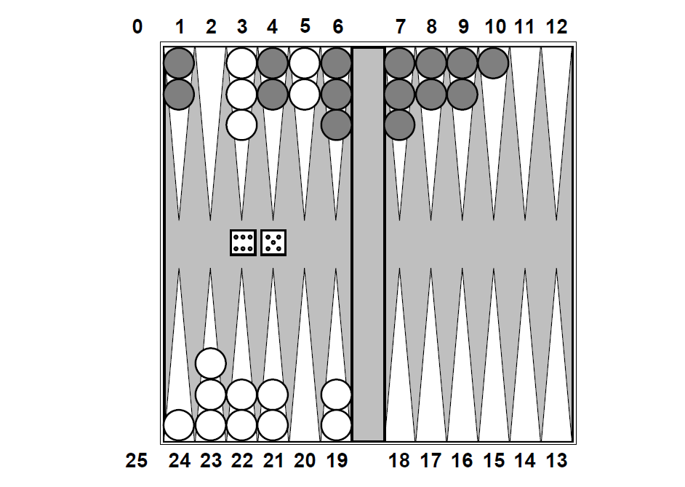
Non-deterministic: backgammon

Slide 65
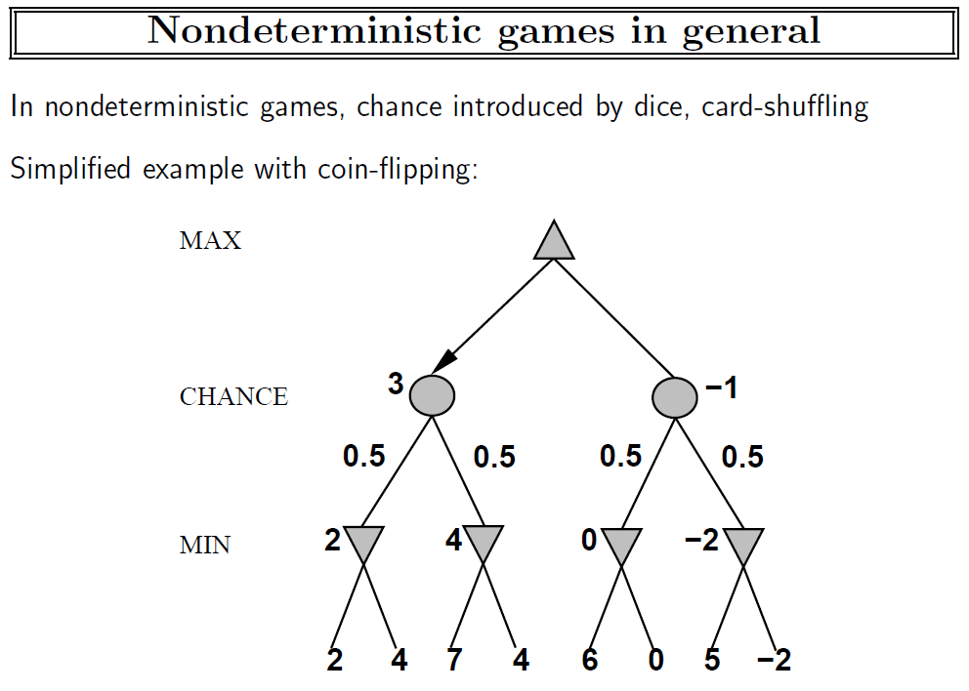

Slide 66
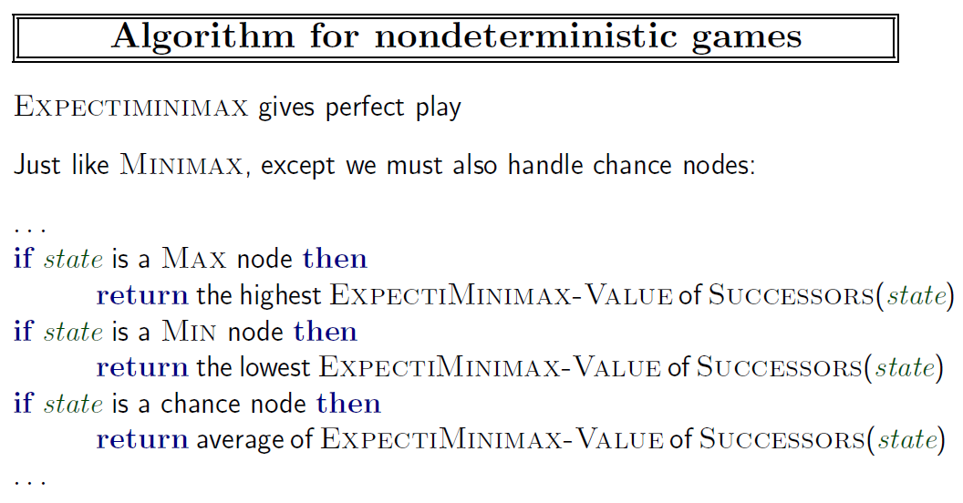

Slide 67
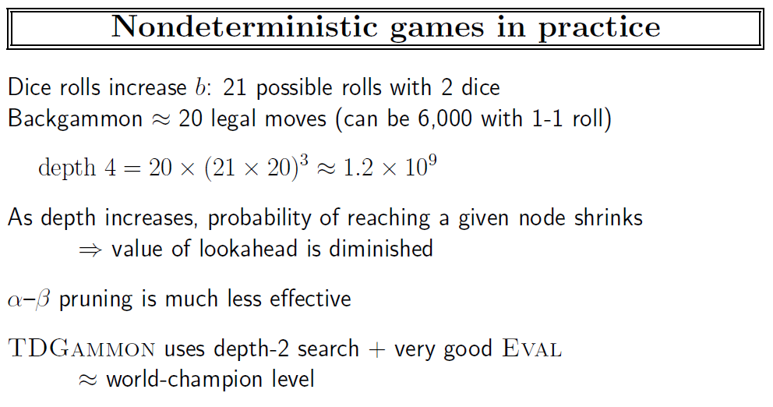

Slide 68
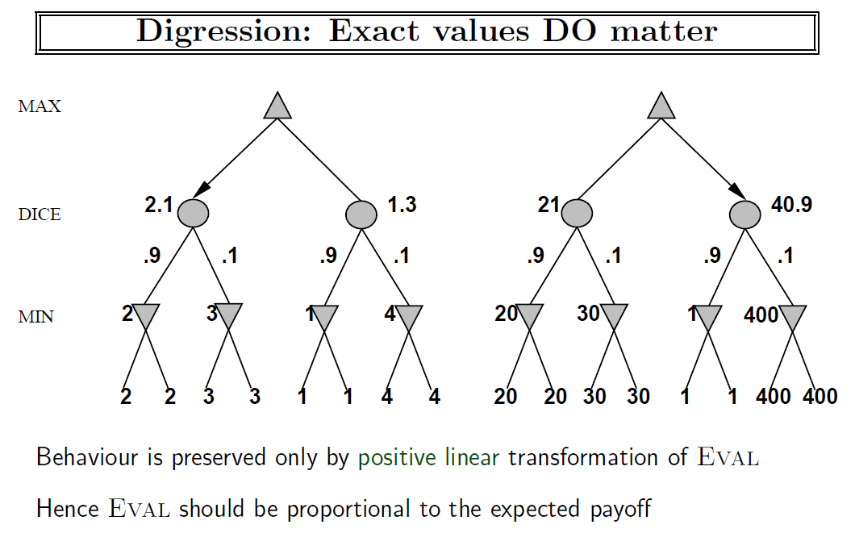

Slide 69
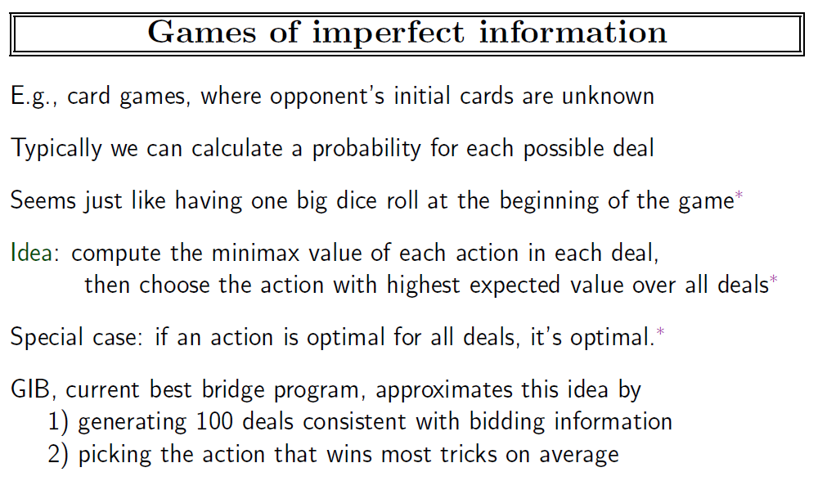

Slide 70
Notes
Arthur Samuel (1959) – Checkers
linear combination of features, alpha-beta pruning
Gerry Tesauro (1995) – Backgammon
TD-learning (combination of dynamic programming and Monte Carlo) – method invented by Sutton (1988)

Slide 71
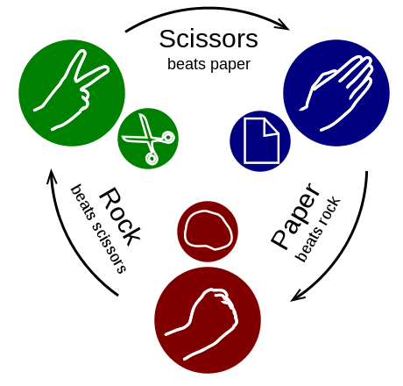
Simultaneous Games
By Enzoklop - Own work, CC BY-SA 3.0, https://commons.wikimedia.org/w/index.php?curid=27958688

Slide 72
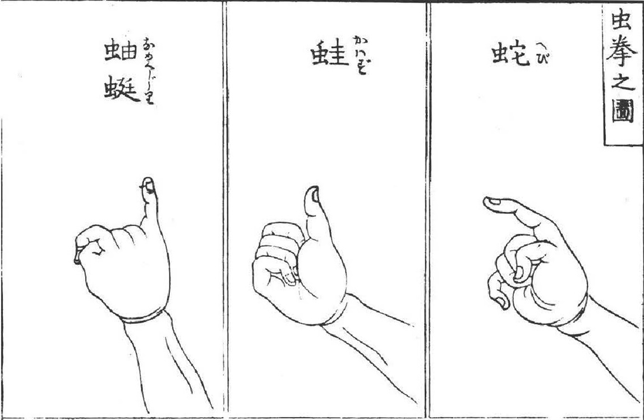
Mushi-ken
By Linhart, Sepp. "Die Repräsentation Von Tieren Im Japanischen Ken-Spiel: Versuch Einer Interpretation." Asiatische Studien: Zeitschrift Der Schweizerischen Asiengesellschaft 65.2 (2011): 541-61.Yoshinami and Gojaku. 1809. Kensarae sumai zue (拳會角力圖會). 2 vols. Edo: Murataya, Jirobe, Osaka: Kawachiya Taisuke, Bunka 6., Public Domain, https://commons.wikimedia.org/w/index.php?curid=37139430

Slide 73
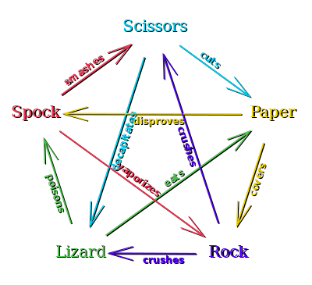
Rock-Paper-Scissors-Lizard-Spock
By VidTheKid - Own work, Public Domain, https://commons.wikimedia.org/w/index.php?curid=6560997

Slide 74
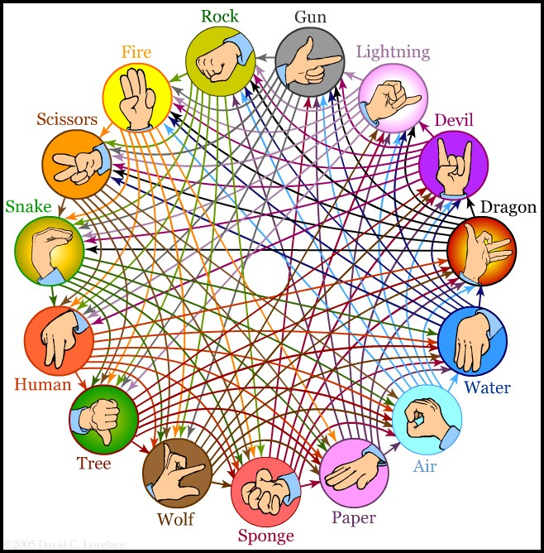
Versions with up to 101 Weapons ☺
http://www.umop.com/rps7.htm
http://www.umop.com/rps15.htm
http://www.umop.com/rps101/rps101chart.html

Slide 75
Strategies for zero-sum games
Pure Strategies
Mixed Strategies

Slide 76
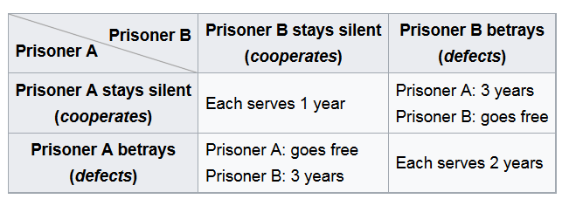
Non-zero sum games
Collaborative Games
Prisoner’s Dilemma
Nash Equilibrium
when no participant can gain by a unilateral change of strategy

Slide 77
Iterated Prisoner’s Dilemma
Nash equilibrium is again to defect at all turns
Proof by induction starting from the last turn
This applies even if the number of turns is unknown but is limited
Evolution of cooperation
If the number of turns is random (Aumann 1959)
Best strategy – tit-for-tat with small probability of switch (Rapoport, Axelrod, early 1980s)

Slide 78
Summary
Games are fun to work on!
They illustrate several important points about AI
Perfection is unattainable → must approximate
AlphaGo uses supervised learning, reinforcement learning, as well as neural networks (for the evaluation function)
Good idea to think about what to think about

Slide 79
AI

